Slide 1
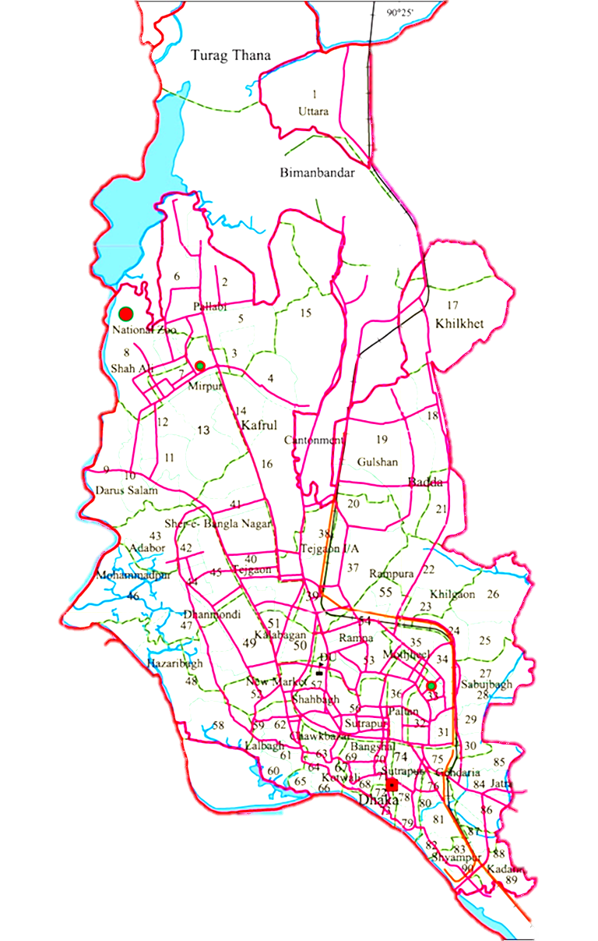



Presented By:
Md. Rahat-uz-Zaman
Shadmaan Hye
Raihanul Islam Refat
Department of Computer Science and Engineering
Khulna University of Engineering & Technology (KUET)
KUET_MANJARO

Slide 2
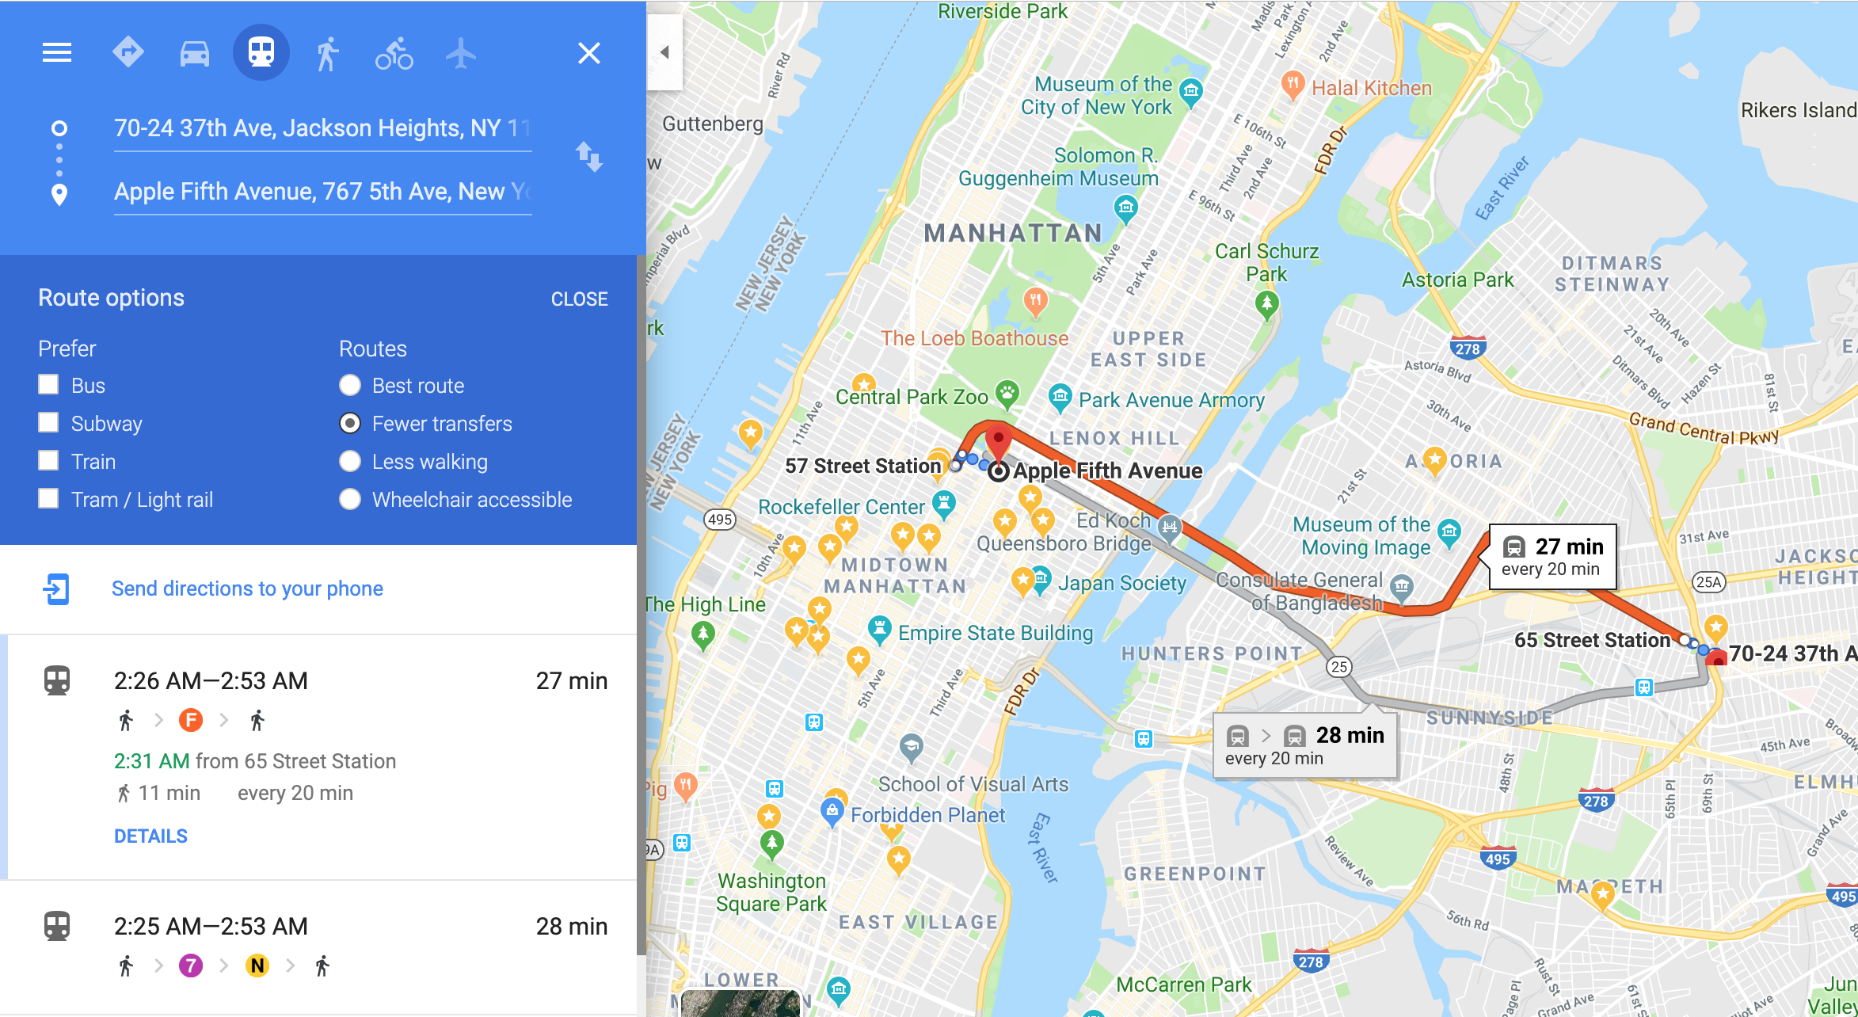
To build an efficient software system for
Mr. Efficient
Such that, the optimal route will always be shown to him given his current and destination locations
Problem
Statement

Slide 3
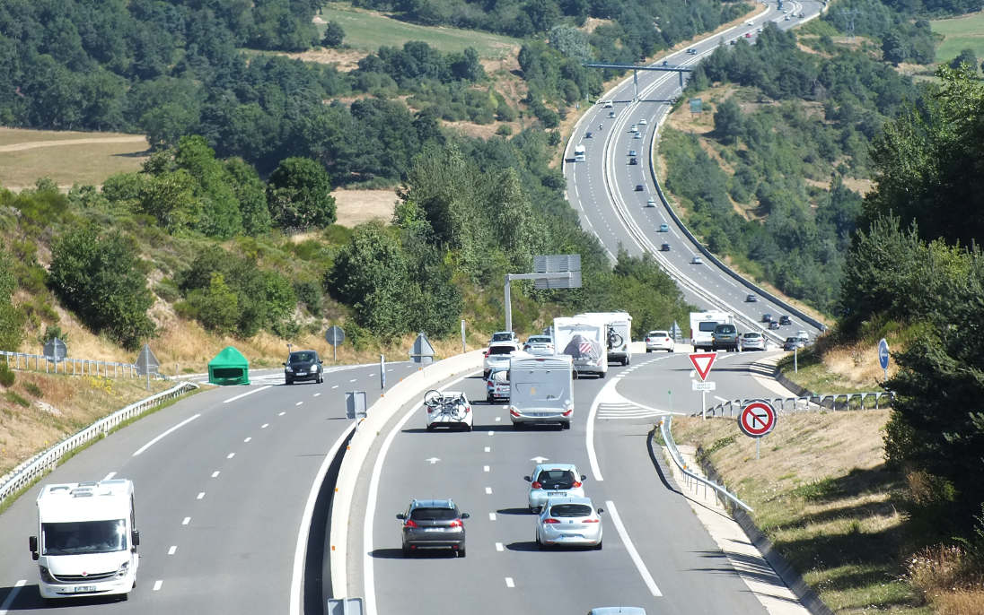

Solution
Shortest + Cheapest Travel route
No Problem 4
No Problem 1
Problems Tried To
Solved
Not Problem 2
No Problem 5
Not Problem 6
Not Problem 3
Notes:
85 173 211

Slide 4
Weighted Graph
Greedy
Faster shortest path algo
No negative edge
Dijkstra
Background Study
Floyd Warshall
Bellmann Ford
Shortest Path Algorithm
BFS
DFS

Slide 5
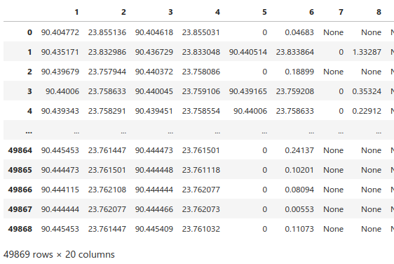
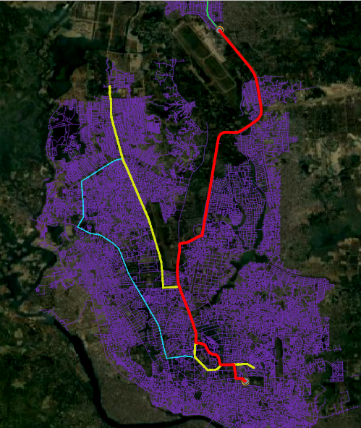
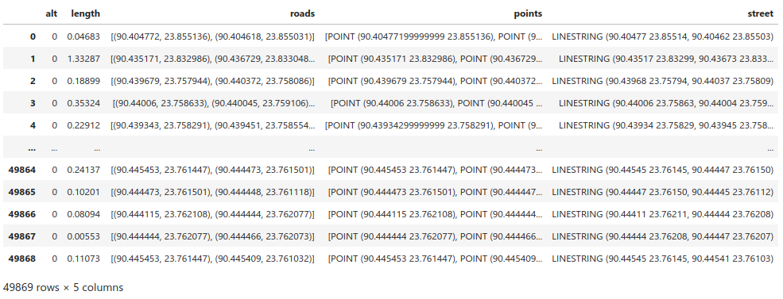
Handeling Datasets
Raw CSV
GeoPandas
KML

Slide 6




Handle Any Input Type
Robustness
CSV
KML
ShapeFile
GeoJson

Slide 7
Now lets jump into the notebook and see the code!!
KUET_MANJARO

